Slide 1
Girl Scout Troop ###
Notes:
Insert Troop number, thank parents for coming to the meeting

Slide 2
2019 Goals
Introduction to Girl Scouts and Troop Leaders
Troop Expectations and Practices
Year in the Life of a Girl Scout
Costs and Uniforms
Resources
Notes:
Items that will be discussed.

Slide 3
Notes:
We always start each meeting with the Girl Scout Promise and Law. Please encourage parents and girls to stand and repeat them with you. If doing this virtually, ask that everyone mute their microphones.

Slide 4
Parent Promise & Law
A Girl Scout parent understands the true program of Girl Scouts.
Gets her daughter to and from meetings on time.
Knows a troop is a team effort. Sees the job through to the end.
Sets a good example.
Is enthusiastic and cheerful.
Does not consider the leader a baby-sitter.
Brings troop problems to the leader first.
Always does his or her part willingly
And is aware that Girl Scouting is for all girls.
On my honor, I will try
To encourage and support my Girl Scout and her troop,
To help lead girls at all times,
And to always keep it fun.
Notes:
Family Promise taken from https://www.girlscouts.org/en/about-girl-scouts/who-we-are.html

Slide 5
GSUSA Mission
Girl Scouting builds girls of courage, confidence, and character, who make the world a better place.

Slide 6
Girl Membership
Notes:
Select to play video on presented screen

Slide 7
Troop Expectations

Slide 8
Who are we? . Our Expectations:
Financial hardship will not preclude participation
Parent participation is needed and expected – Girl Scouts is time with your daughter
We are all here for the same reason: for the benefit of all girls in the troop. Respect and kindness will be required.
Parents will be expected to attend the troop meetings if their child needs special attention
Notes:
Introduce troop leaders, feel free to share your Girl Scout story.

Slide 9
Parent Involvement
Girl Scouts is an experience you have with your daughter
Troop Product Manager
Teach a Badge
Troop Supporter
Troop Treasurer
Cookie Booth Support
Driver
Notes:
Set clear expectations with your parents, let them know how much support you will need from the beginning. This is a great place to introduce the Parent Interest survey, to find out how your parents can be engaged with the troop.

Slide 10
Attendance Guidelines
Girl Scouts is a ratio-based program, meaning that we must always have sufficient girl to adult ratios, if your child does not attend on a regular basis, we may offer your child’s spot to a new member.
Please be respectful and let us know if you will not be attending, due to vacation, illness, or change of desire to participate.
If this troop does not meet your needs and/or schedule, contact council for other options.
Notes:
You may customize this slide to better suit your troop requierments.

Slide 11
Service Projects
Add plan for community service/take action projects
Notes:
For Example: Service Projects and Take Action Projects are a vital part of Girl Scouts and provide a learning experience in which your daughter will be required to participate often. Badges and/or patches will be awarded to those that participate in these projects. We will try to make sure the project is age appropriate and within the ability of the girls to complete. We will ask for suggestions for projects, please share your ideas. This is our way of giving back to our community. The projects could include donations, environmental cleanup, or learning about local history or how to make a difference.

Slide 12
Accountability for the Girls
Add expectations for girls
Notes:
For Example: We will have a chart for the girls registered with our troop. At each meeting, the girls will mark with a star or sticker of choice, if they have attended the meeting, paid dues, brought necessary materials (i.e. books) and participated in the current service project. This will not only help your daughter to recognize when they have fulfilled their troop responsibilities, but assist our leaders in preparing awards for participation, such as treats, special patches, and fun events.

Slide 13
Rules of the troop
Pick up and drop off on time
Troop Agreement
Respond to communications timely
Respect deadlines - troop dues, product sales earnings, permission forms, etc.
Remember, we are volunteers

Slide 14
Money Earning
gsLearn
How the troop funds the FUN
Fall Product Sale
Cookie Sale
Dues: Set by troop, paid monthly, quarterly
or annually

Slide 15
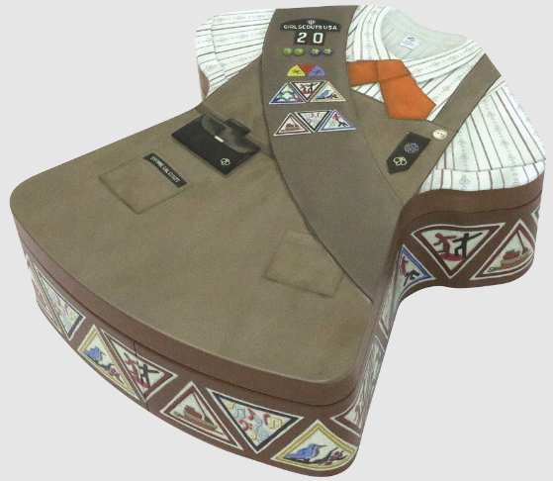
Product Sales
gsLearn
Fall Product
Girl Scout Cookies

Slide 16
Troop Dues
Dues for our troop are $(money) per month. Due on or before the (date) meeting of each month.
Dues cover the cost of program supplies, awards and gifts, most troop outings/field trips, and leadership tools.
The cost of Troop dues is determined by the troop annually averaging the cost of the previous year’s expenditures and product sales.
Please allow your child to bring her dues in cash to each meeting. Perhaps you can assign the task at home to “earn” her dues. This encourages responsibility and financial management on their level.
Notes:
Update slide as necessary for your troop
Dues are separate from the $25 membership fee paid to GSUSA when registering. The $25 covers administrative costs, accident insurance, and helps fund our Council. This money does NOT go to our troop.

Slide 17
Troop Funding
Troop funds consists of all monies paid to the troop by parents in the form of dues and donations, product sales events, and donations from sponsors.
Troop funds are managed by the Troop Leader with the advice and oversight of the Girls.
Troop funds are budgeted to cover costs of meeting supplies, patches, badges, and partial expenses for girls and required chaperones for troop activities, trips, and camping.
Notes:
NOTE TROOP LEADERS: Giving the parents the option to vote can give them buy in so they feel responsible for the troop. However, this may cause issues with you trying to collect these fees at later dates.

Slide 18
Girl Scout Expenses

Slide 19
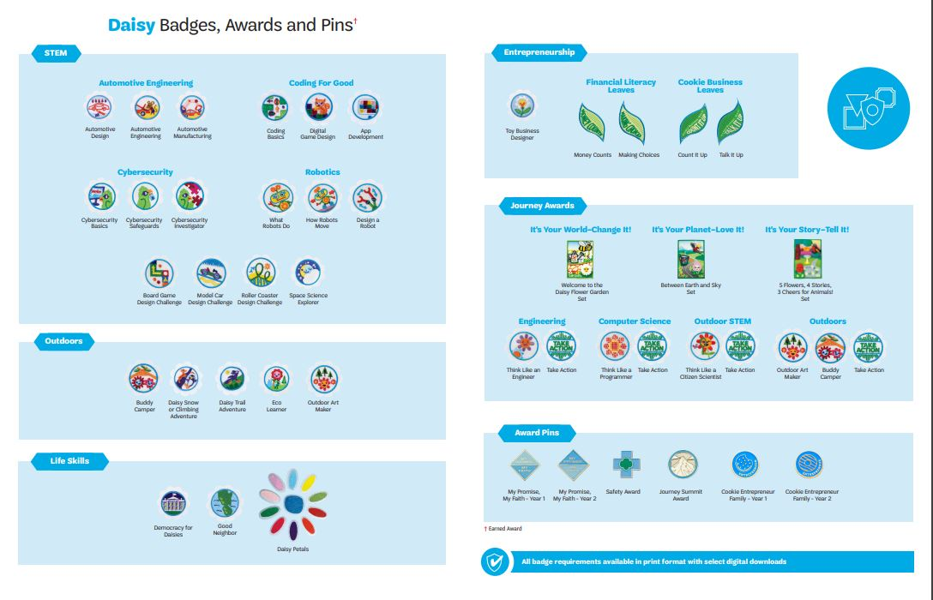

Slide 20
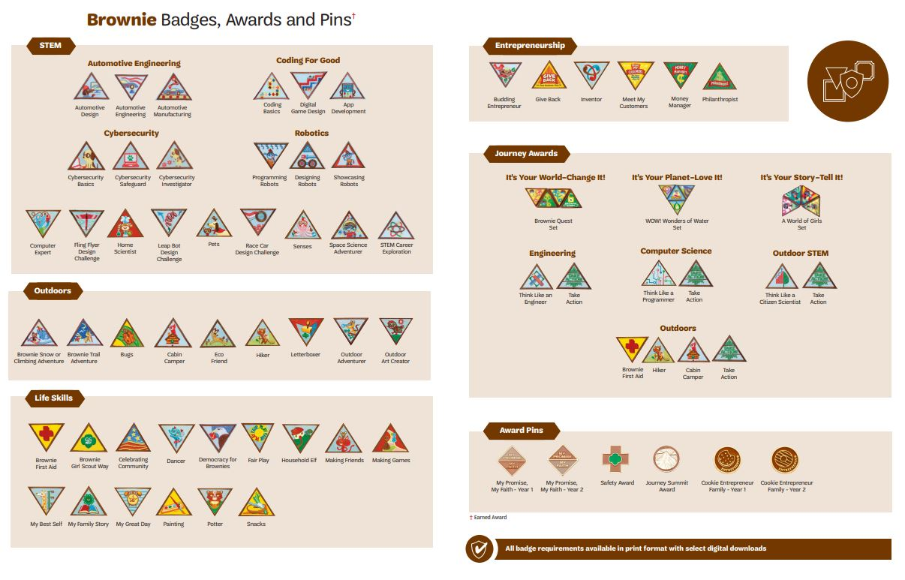

Slide 21
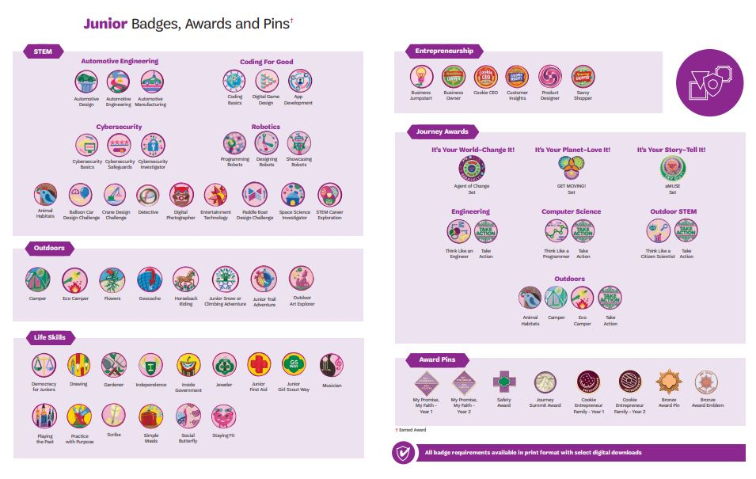

Slide 22
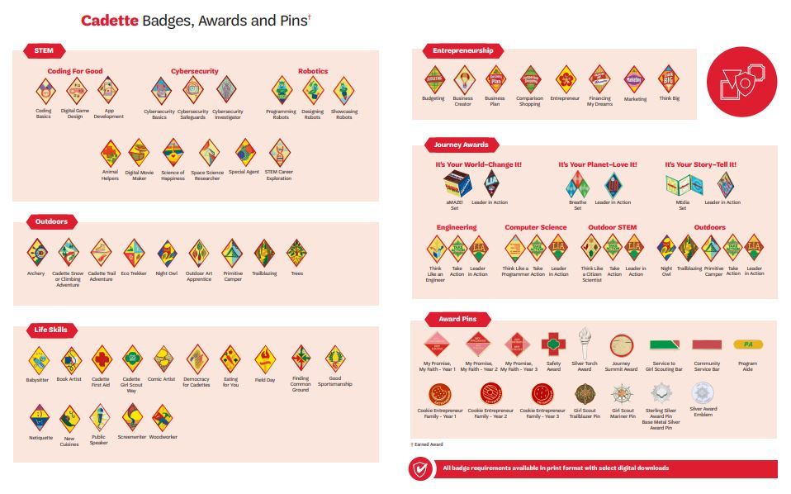

Slide 24
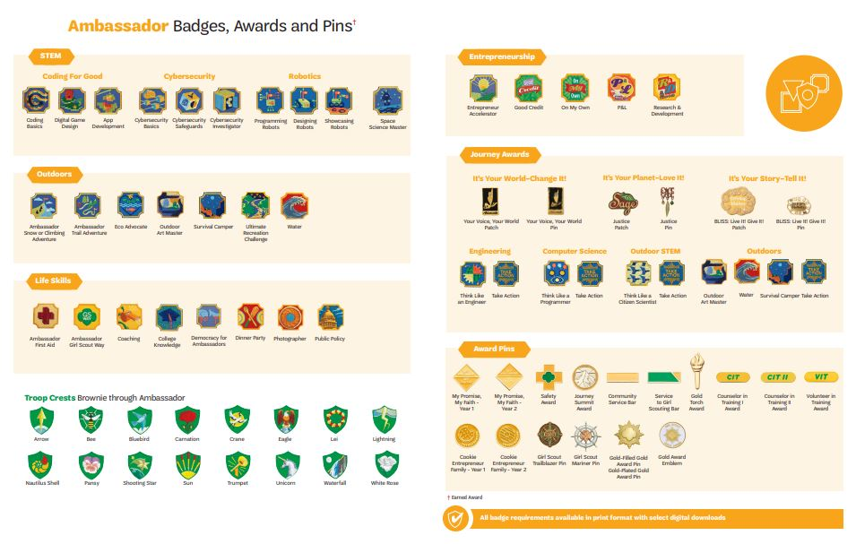

Slide 25
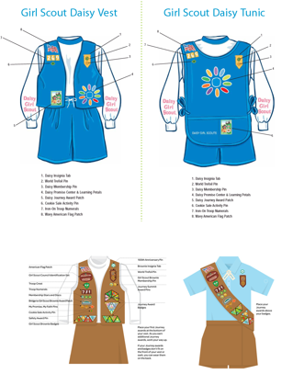
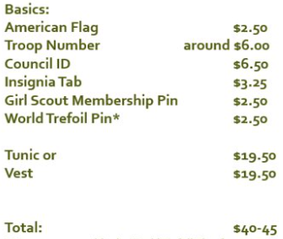
Uniforms (spring 2021)
gsLearn

Slide 26
Calendar
October: Start of Membership year, end of Fall Product Sale
January: Door to Door Cookie Sales
February: Cookies arrive, girl delivery
March: Cookie Booths, Girl Scout Week
April: Volunteer Appreciation, Early Bird Renewal
May: End of regular meetings
June-August: Resident Camp, Summer activities
September: On-time renewal, Troop kickoff, Fall Froduct Sale begins
Notes:
If there are specific things you will be doing, such as summer activities, this is where you will want to discuss these so parents will be prepared

Slide 27
Resources

Slide 28
Forms
2020 Centennial
Permission forms must be signed if the troop leaves the assigned meeting place (i.e., field trips)
Health History & Consent forms must be complete and will be always carried with the troop leader
COVID-19 Waiver filled out once for the year
Symptom Checker filled out for each in-person meeting
Notes:
All of these forms can be found on the Forms and Resources page on gsutah.org

Slide 29
COVID Information *Subject to change/update often
Masks are required to be worn at every in-person meeting and event regardless of local and state mandates
Troops are unable to meet at homes, meet outside whenever possible
Carpooling is allowed, 2 girls to a row
All supplies need to be for individual use only
Notes:
Masks are required to be worn at every in-person meeting and event regardless of local and state mandates. Girl Scouts wear face coverings (masks) not only to protect themselves but to protect others. Face coverings are a civic responsibility and a sign of caring for the community. Parents will be required to take their Girl Scouts temperature before the meeting. Please do not send your Girl Scout to the meeting if she is feeling ill. Hand sanitizer is highly recommended for all girls to keep on them and use regularly.

Slide 30
National Convention
Customer Care -
Phone: 801-265-8472
email: info@gsutah.org
web: gsutah.org
Retail –
Murray: 801-716-5141
American Fork: 801-716-5107
Volunteer Tool Kit –
A planning guide for troop leaders to share meeting plans with parents, where you can find badge activities and information on raising awesome girls.

Slide 31
Our Contact Information
National Convention
Troop Leader
Phone
email
Co-Leader
Phone
email
Product Manager
Phone
email
Notes:
Add contact information for ALL leaders, co-leaders and product sales managers

