Slide 1
Digital Cookie
Notes:
Digital Cookie

Slide 2
DC24 Cloud = Digital Cookie
Notes:
Watch for your welcome email from Digital cookie on January 16, 2024 to register and set up the Girl Scout storefront.

Slide 3
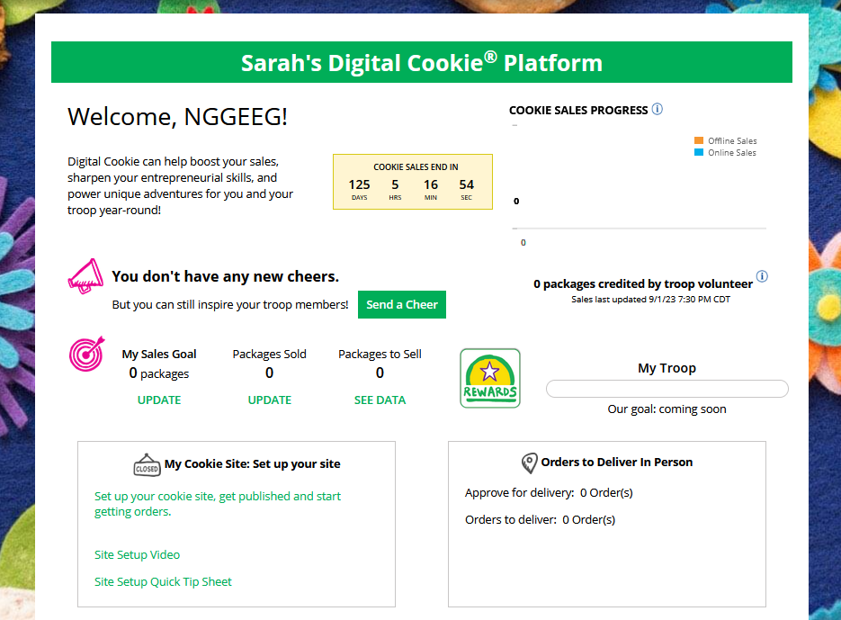
Step 2-Setup Your Site
Have multiple Girl Scouts? Easily switch between each site here.
To setup the Girl Scout’s cookie site, click on the “Set up your Digital Cookie site…” link in the My Cookie Site section, or the “Site Setup” link at the top.
Notes:
To setup the Girl Scout’s cookie site, click on the “Set up your Digital Cookie site…” link in the “My Cookie Site” section, or the “Site Setup” at the top

Slide 4
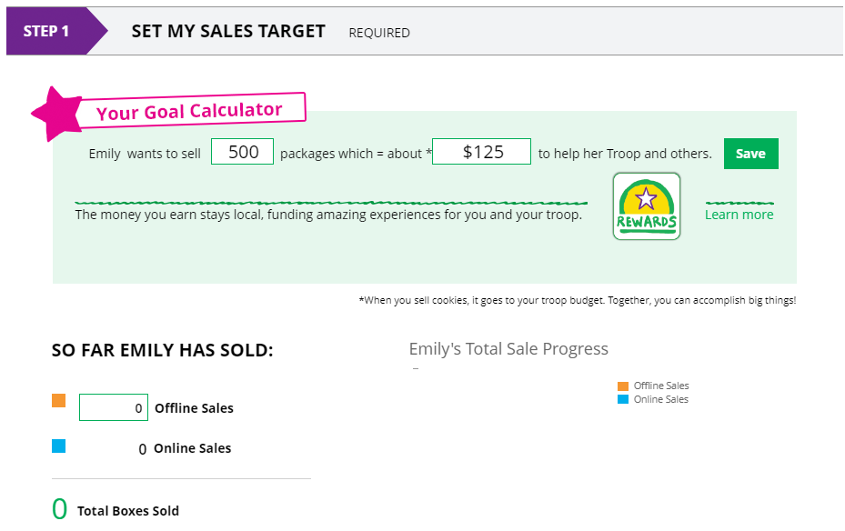
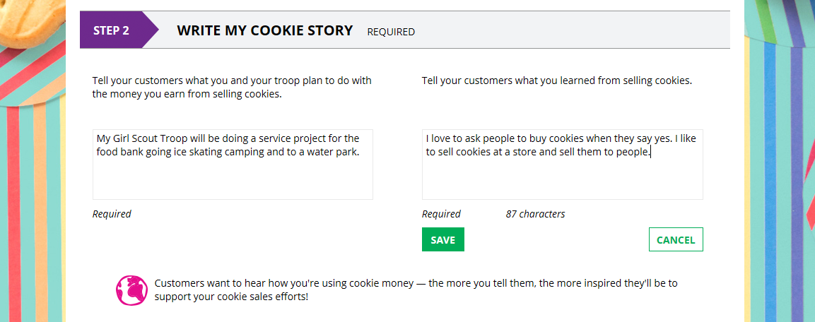
Goal Setting: Set My Sales Target
Setup Your Site
2
1
3
4
5
6
7
Notes:
Goal Setting: Set My Sales Target
Girl Scouts enter how many packages of cookies they are working to sell this year through online and offline sales.
When the information is entered, the calculator will show how much money the troop will get from her hard work.
Clicking on “Rewards” will take you to your council’s rewards tab (if available) to see what rewards the Girl Scout might want to work towards. Not all rewards are shown. Digital Cookie does not have the ability to add Gift of Caring, Troop PGA, etc.
Girl Scouts can enter any offline packages they have sold so their customers will see their total sales, not just their digital sales.
My Cookie Story
5. Girl Scouts tell their customers about a troop goal and why it’s important.
6. Girl Scouts share what they’ve learned from the cookie program.
7. Save their story. They can make edits to it at any time.

Slide 5
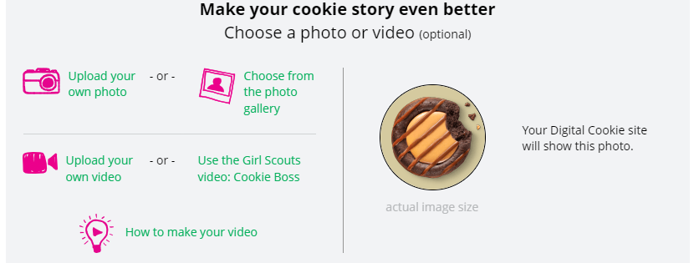
Photo/Video Upload
Setup Your Site
Girl Scouts who uploaded a photo or video of themselves sold more than double the boxes on average than those who did not.
1
2
3
Notes:
Photo/Video Upload
1. Girl Scouts can choose to upload a photo or use a picture from the gallery.
2. Or, Girl Scouts can upload a video or use the “Cookie Boss” video.
3. Bonus! Girl Scouts can get tips on how to make a great video.
Girl Scouts who uploaded a photo or video of themselves sold more than double the boxes on average than those who did not.

Slide 6
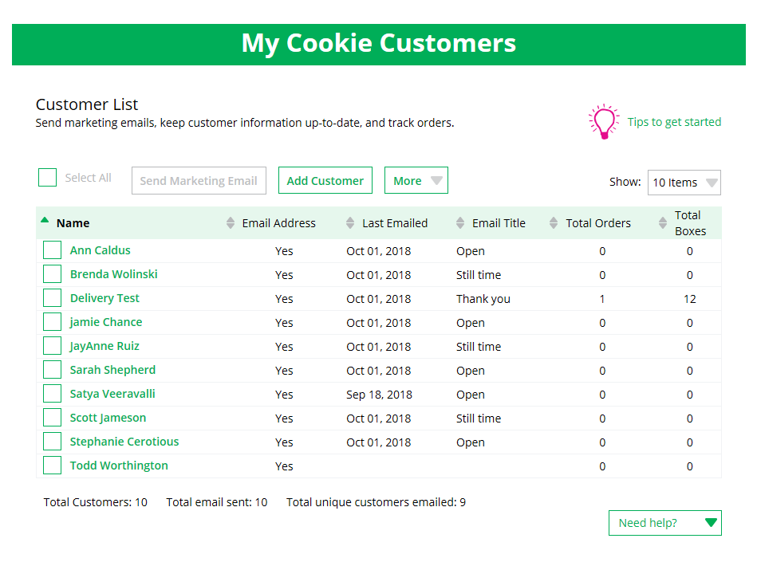
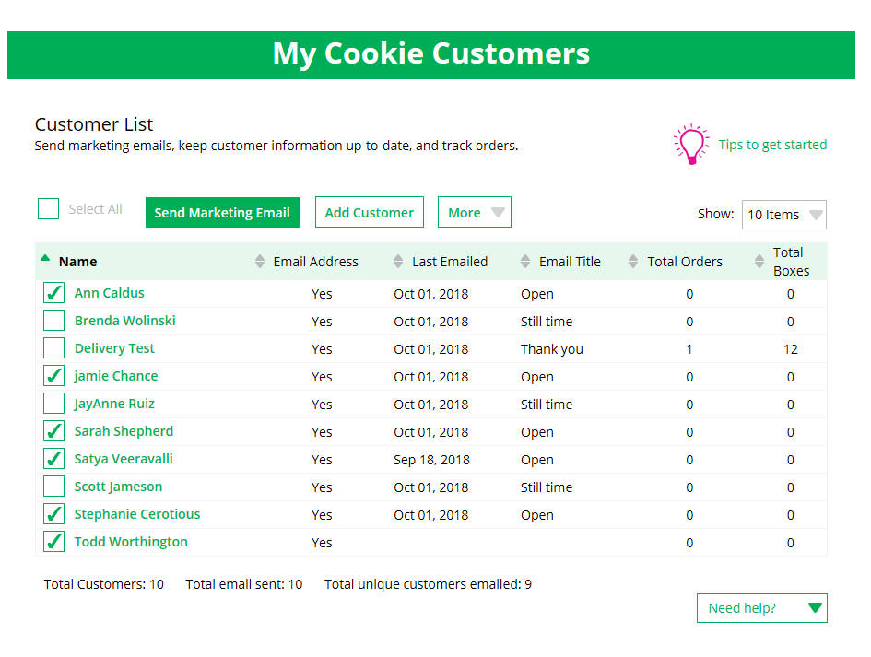
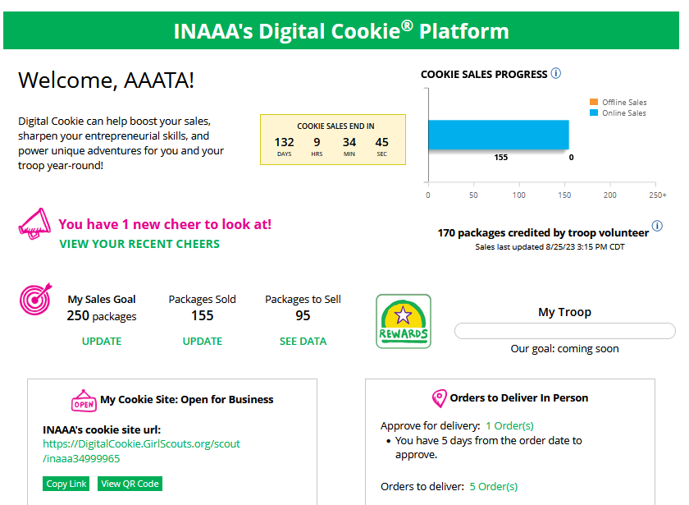
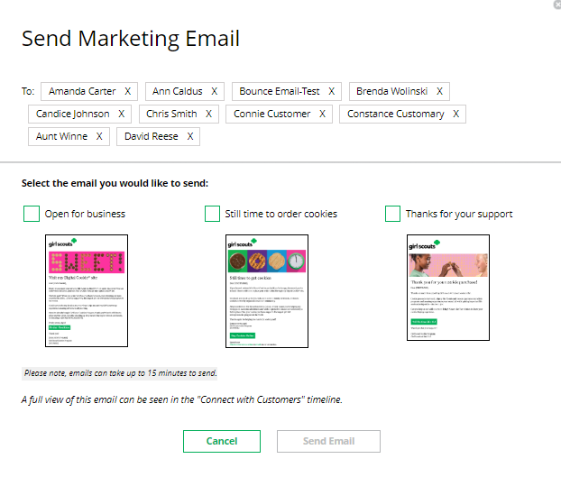
Invite Customers beginning January 16, 2024
Copy URL
Email link or share QR code
Add or import customers
Send one of three marketing emails
1
2
4
OR
3
Notes:
Girls can add customers individually or import. Great opportunity to import from fall sale customer list. Work is already done! Click on the import dropbox for a spreadsheet to use. This is a quick and easy way to add a lot of emails at once.
To send emails, click on box in front of customer name and click “send marketing email”
Select which email to send “Open for business”
Customer page updates with which email was sent and when
Girl Scouts can also send customers a link to their Digital Cookie website OR generate a QR code for them to use directly from their home page.
Customers who purchase directly from a link won’t be reflected as an email sent in the totals and will not be counted toward the email rewards. But their orders are treated the same no matter how they reached your website.
At the end of the sale, you can export the customer list to use in the fall sale

Slide 7
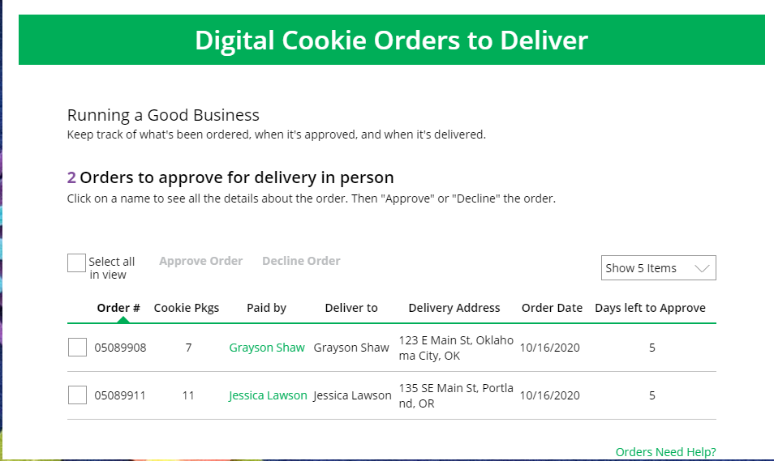
Orders Tab: In-person Delivery Orders
Click on the “Paid by” name to review customer and order details
When determining whether to approve or decline the order, consider:
Is the customer a known and trusted individual?
Are you willing and able to get the cookies to the customer’s location before the end of the sale. Pay close attention to the delivery address and check for out of state customers. No refunds will be given once approved.
AND
Do you have or will you have the inventory available?
If so, “Approve Order.”
Orders must be approved or declined within 5 days or the order will be automatically delined.
Notes:
In-person delivery orders
If Girl Scouts receive an In-Person Delivery order that needs to be approve and you have not approved the order by midnight, you will receive an email from email@email.girlscouts.org with the subject “Action required: you have an in-person delivery request!” letting you know your Girl Scout has received one or more orders for delivery.
On the orders tab, you will see a list of all orders needing approval, including the customer order number, number of packages in each order, the customer’s address, when the customer placed the order, and the number of days you have to approve it until it reverts to the customer’s second choice option.
Orders must be approved or declined with in 5 days or the order will be automatically declined.
::Read slide on determining whether to approve order::
If caregivers are unable or unwilling to fulfill the customer’s order, click “Decline Order” and the order will default to whatever second option the customer has selected: “Cancel” or “Donate”.

Slide 8
Orders Tab: In-person Delivery Orders
Orders to Deliver
Orders must be marked as delivered to update cookie inventory correctly.
Select all
OR
Select a customer
Notes:
Once you have delivered the cookies, log back into Digital Cookie and mark those orders delivered.
When they are marked as delivered, they will move down into the third section on the page as a completed order.
Please do not skip this step. This helps you keep organized and also helps the troop product manager know who still needs to deliver their orders.

Slide 9
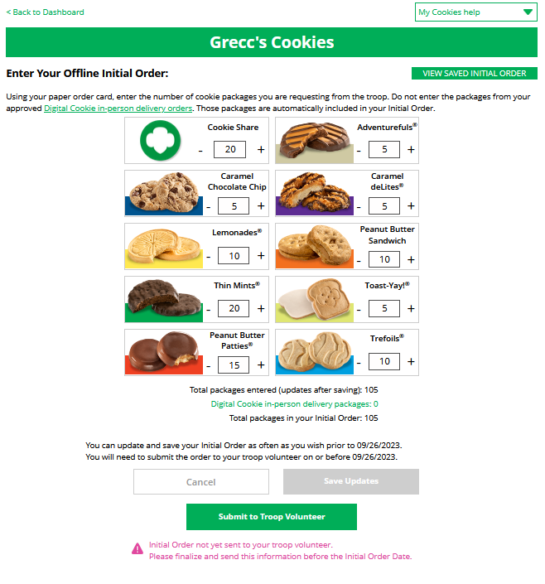
My Cookies-Initial Order Entry
Digital Cookie online girl delivery orders are already included. Do not add them again.
Once submitted, the order will flow to the baker’s ordering system.
Notes:
Enter the cookies your Girl Scout needs to fill the orders from her PAPER ORDER CARD(and any extras you may want). Do NOT include any Digital Cookie in-person delivery orders received online prior to the initial order, those are already ordered for you.
This will need to be completed prior to the due date noted above the “Save Updates” button. After the due date, you can’t make edits to the numbers on this section, and it will only appear at the top of your “My Cookies” dashboard to view.
Once the initial order has been submitted to the troop volunteer, the order will transmit to the baker’s ordering entry system.

Slide 10
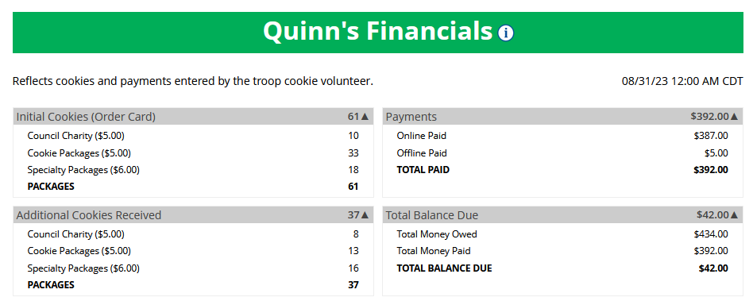
My Cookies Tab-Financials
See how much money is owed for cookies and how that has been calculated.
Notes:
The Financials section is a valuable tool to help you understand the amount due for the cookie sale and how the troop is calculating the amount.
Using the “at a glance” view is a great way to see the overall amounts paid and due. If you need more detail, you can expand any of the sections to find out more.
There are four sections to your financials that you can expand to get details.
Initial Cookies (Order Card)
If you expand this section with the arrow, you will find information on the initial packages you received at pickup, minus any packages you received for in-person delivery orders because those were pre-paid and you do not owe for those.
You will also see any Council or Troop Charity (Gift of Caring) packages that you had orders for.
Additional Cookies Received
This reflects packages transferred to you from the troop after the initial order. For any questions about this or if this figure does not reflect the packages you picked up, please contact your troop product manager.
Payments
Online Paid: This reflects any online payments you received for In-Person Delivery or Cookies in Hand orders
Offline Paid: This amount is any payments for cookies received offline, generally cash or check, that you have given to your troop cookie manager and that they has entered into the system
If this does not match your records, contact the troop cookie manager to help understand the differences.
Total Balance Due
Total Money Owed: The amount you owed for the cookies received at initial pickup and additional cookies received. Note, if your council sells cookies at two different prices, that has been accounted for in your money owed.
Total Money Paid: The total from the “Payments” section.
Total Balance Due: The difference between the amount owed and the amount paid.
If you think any of the figures in this section are incorrect, contact your troop cookie volunteer to compare the information she has on file for you from what you think this should be. This balance can change throughout the program.

Slide 11
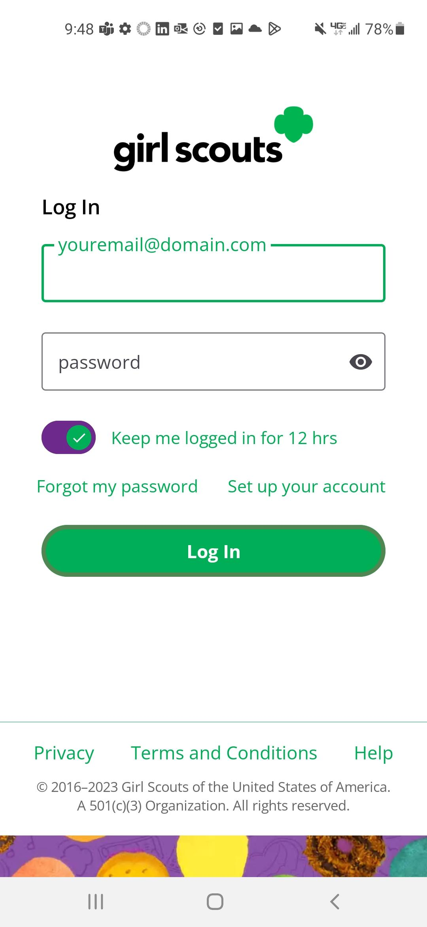
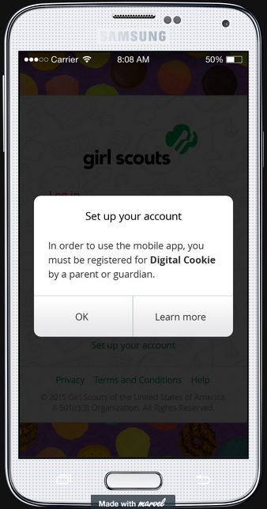
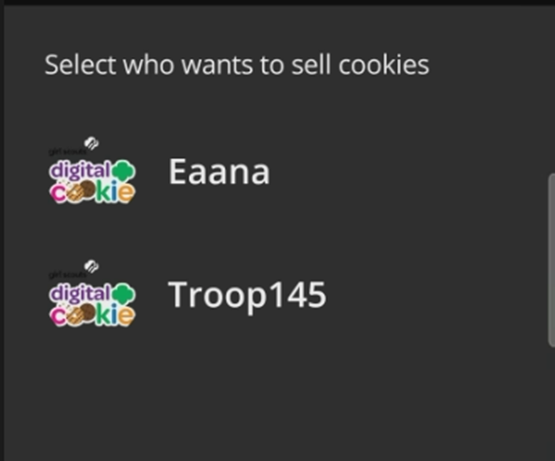
Using the Digital Cookie Mobile App
Download the mobile app from the app store
Log in to the app using the same email and password created in Digital Cookie.
Girl Scout and troop sites must be set up in Digital Cookie using a browser first, before accessing the mobile app.
Select from the Girl OR the Troop persona. Troop login means the sales go to the whole troop-like at a booth.
Notes:
USING THE DIGITAL COOKIE MOBILE APP:
Once the Girl Scout has set up her storefront on the Digital Cookie website, you can then download the new version of the Digital Cookie App.
Girl Scouts must have their site set up and approved prior to being able to log into the Digital cookie app.
Your Troop Product Manager must have troop site set up for the troop site option to appear. Caregivers should use the Troop link when taking credit card payments at the booth.
Once logged in, the user will select which account to use to take an online cookie order. The Girl Scout or Troop. If a caregiver is helping at a booth, they must have their Girl Scouts storefront set up before they can use the app for orders.

Slide 12
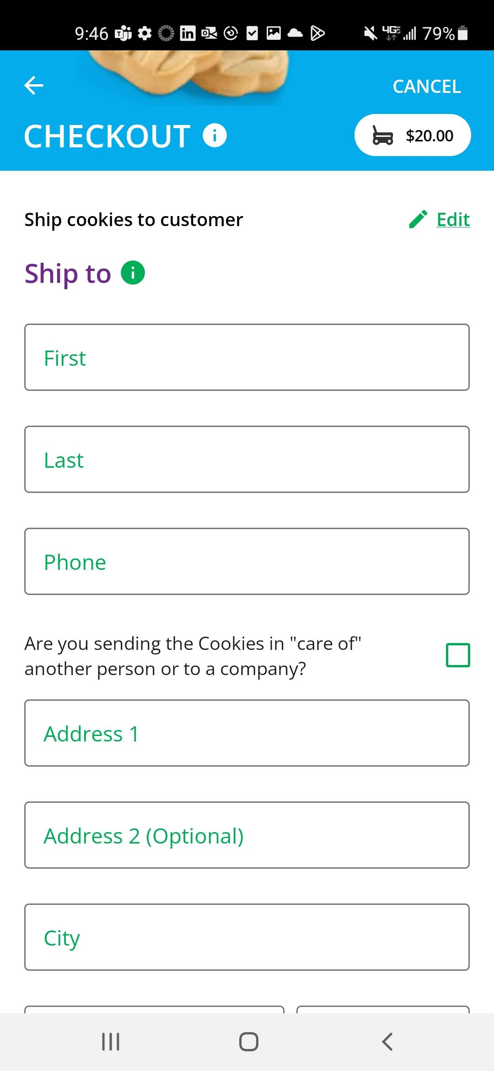
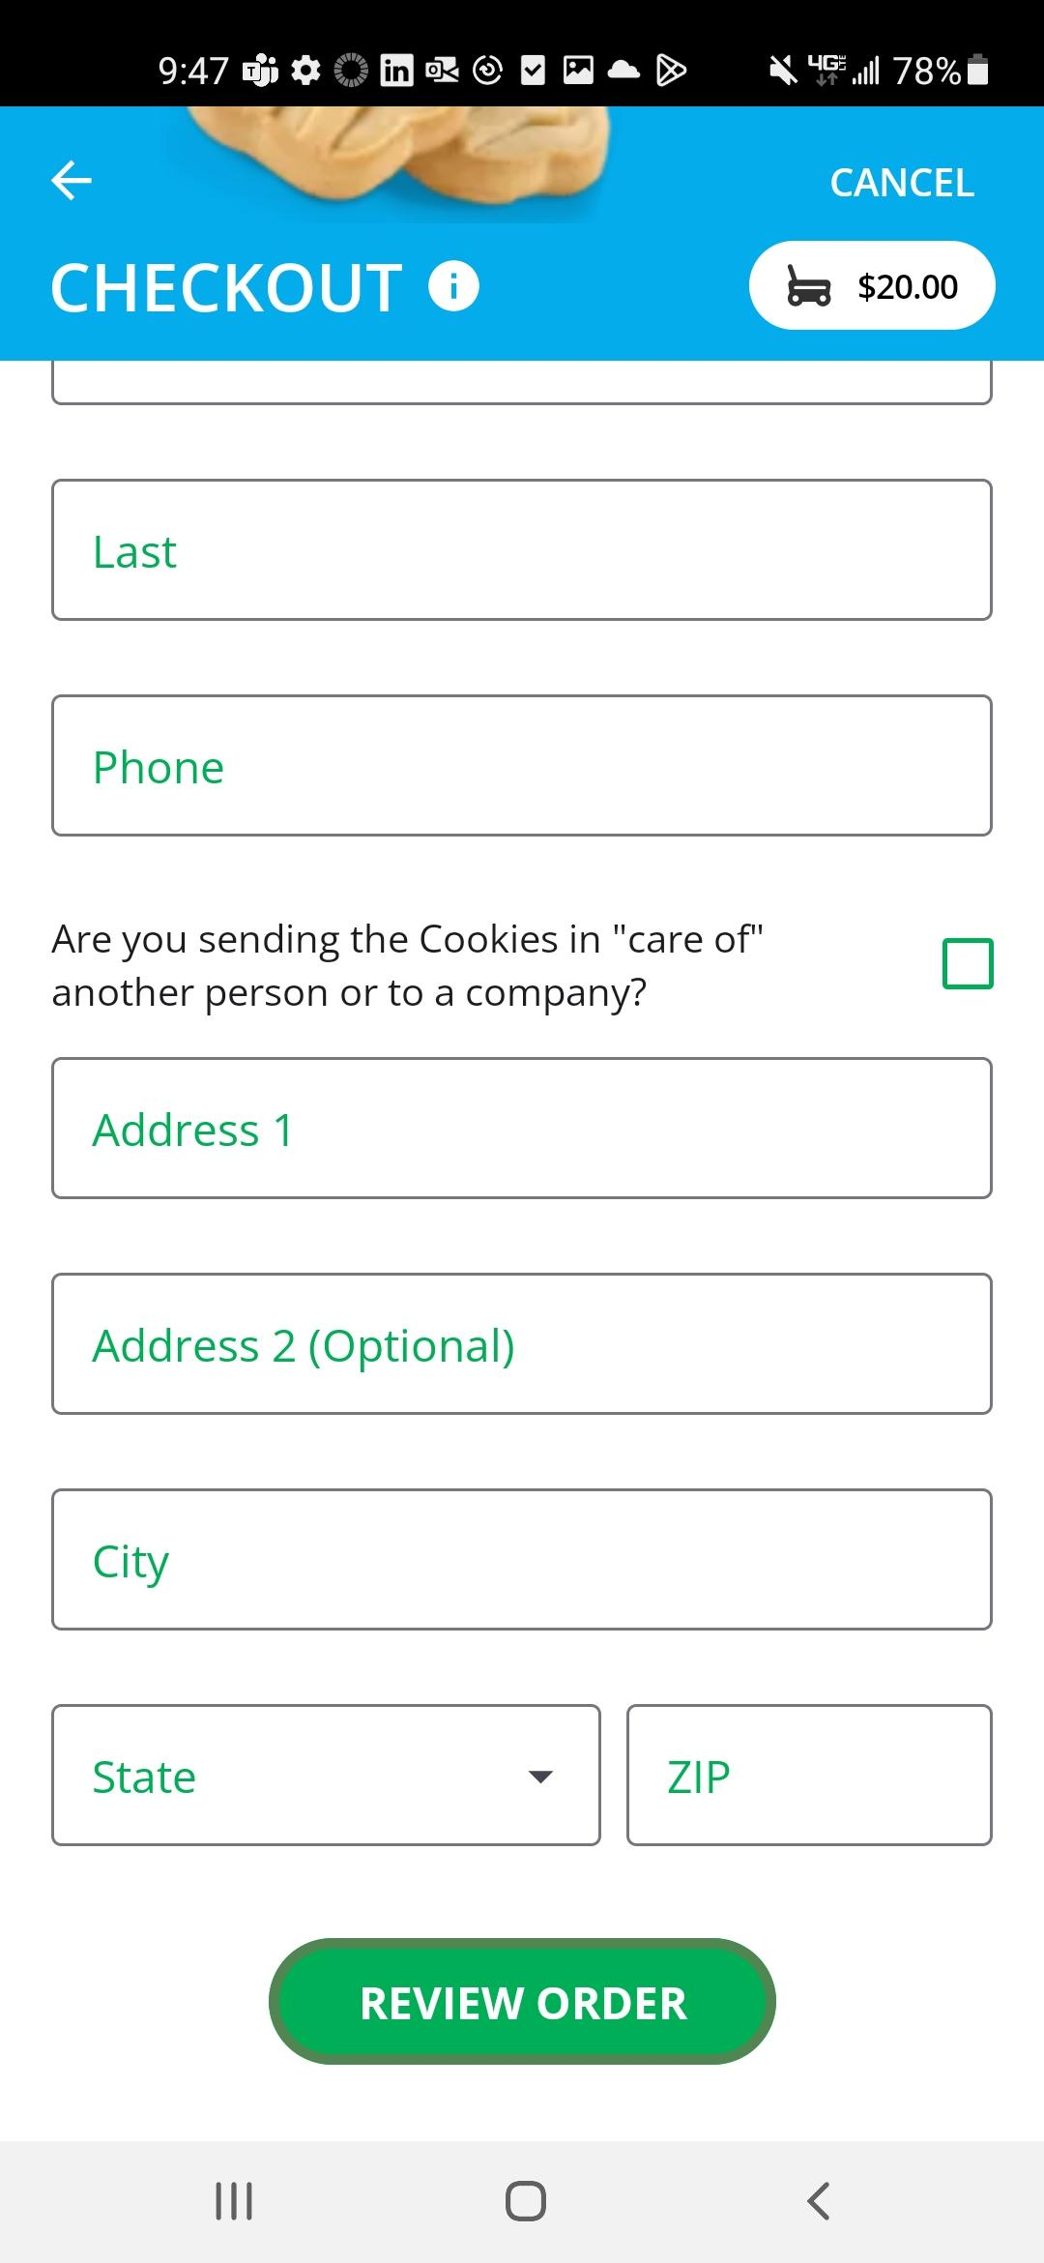
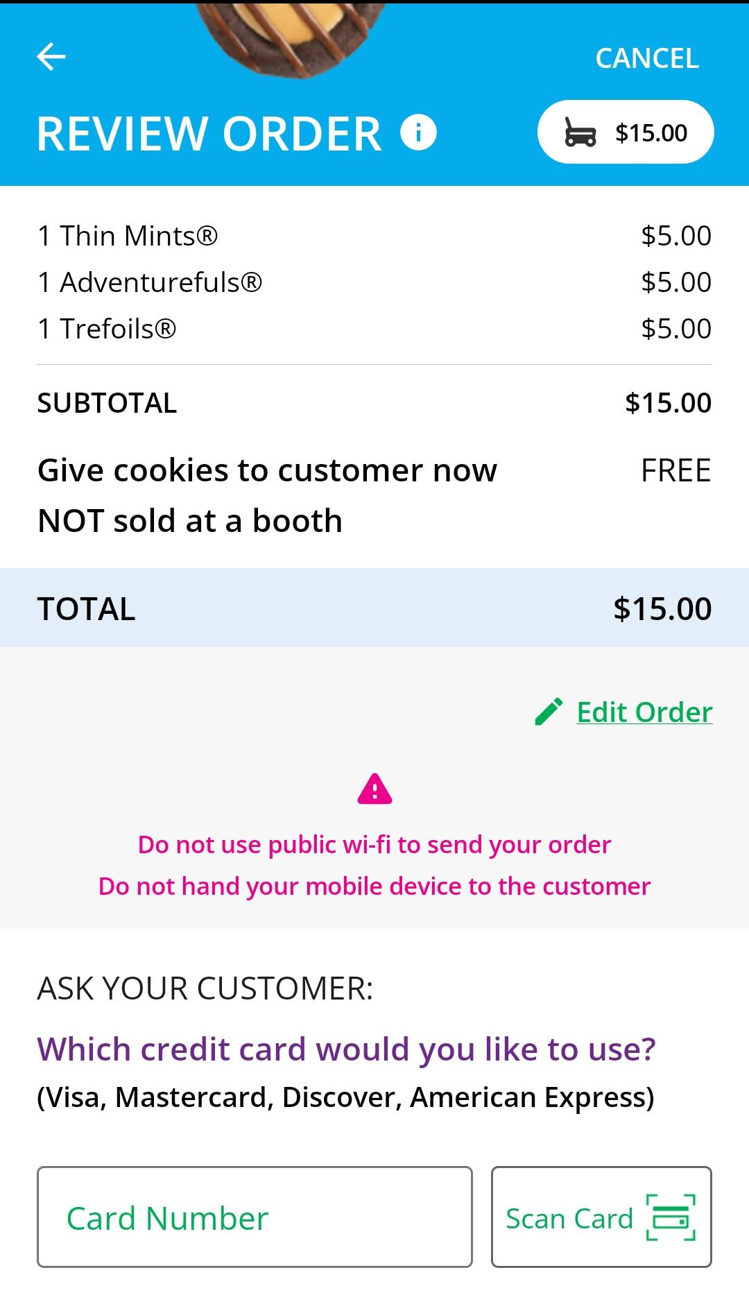
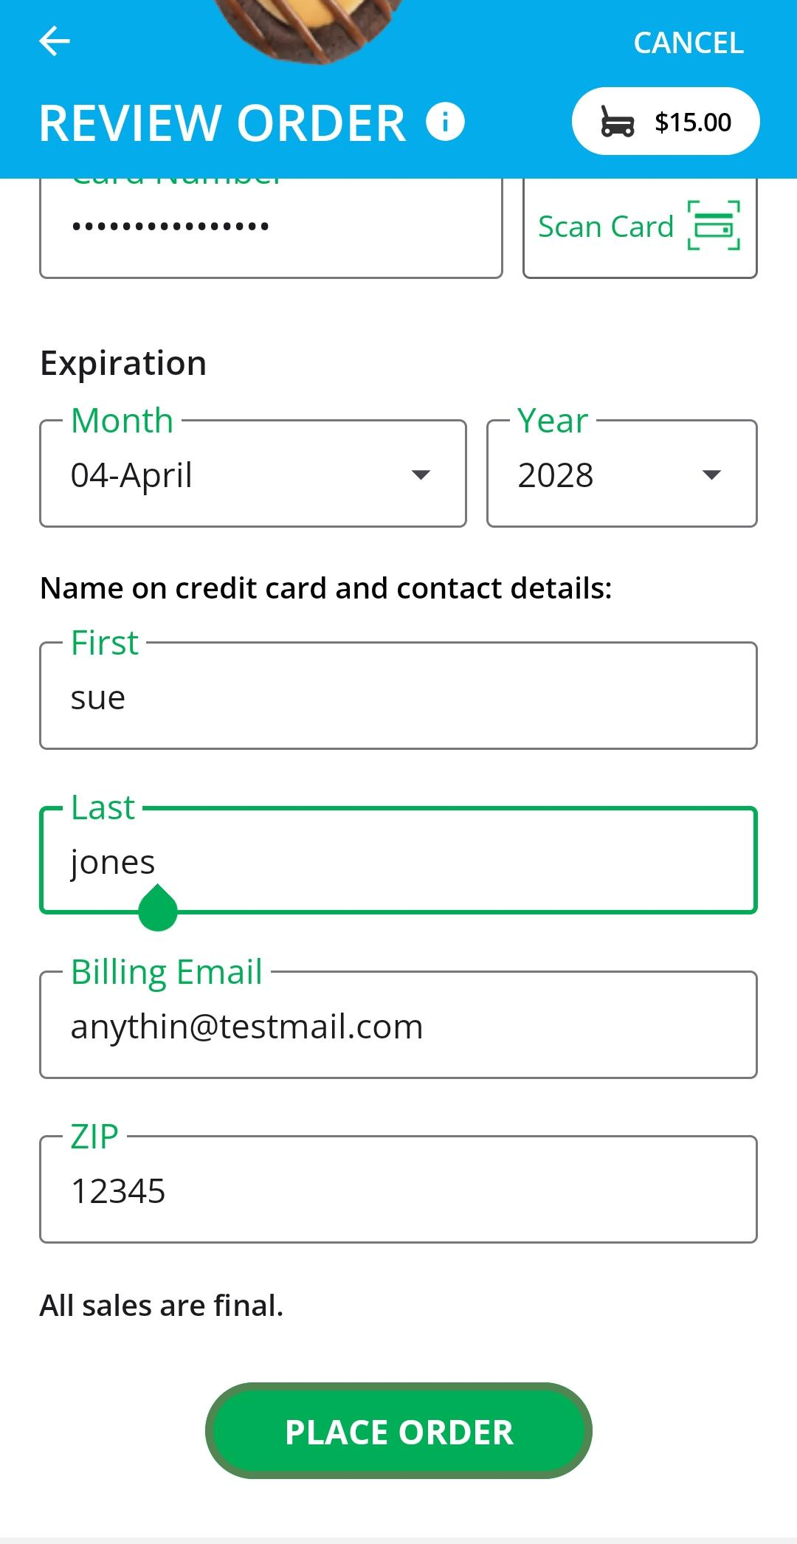
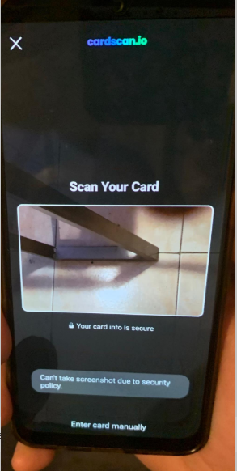
Mobile App-Making a Sale
Delivery or shipped orders
In-hand (Give cookies to customer now) orders
Scan Card
Notes:
If the order is a shipped or delivery order, the Girl Scout or caregiver will complete the customer information for where the cookies will be shipped/delivered to.
Once the cookies have arrived, Girl Scouts can place an order for “cookies in hand” . This means you physically have the cookies and are giving cookies to the customer now. An address is not required for cookies in hand, only the customer’s name, email address, and billing Zip Code.
When entering the credit card information for all types of orders, there is the Scan Card feature to use rather than having the customer verbally tell the Girl Scout their credit card number. Depending on the type of credit card, the customers name might or might not auto populate.
If a customer will not give you their email address you can enter DOC@gsutah.org for the order.

Slide 13
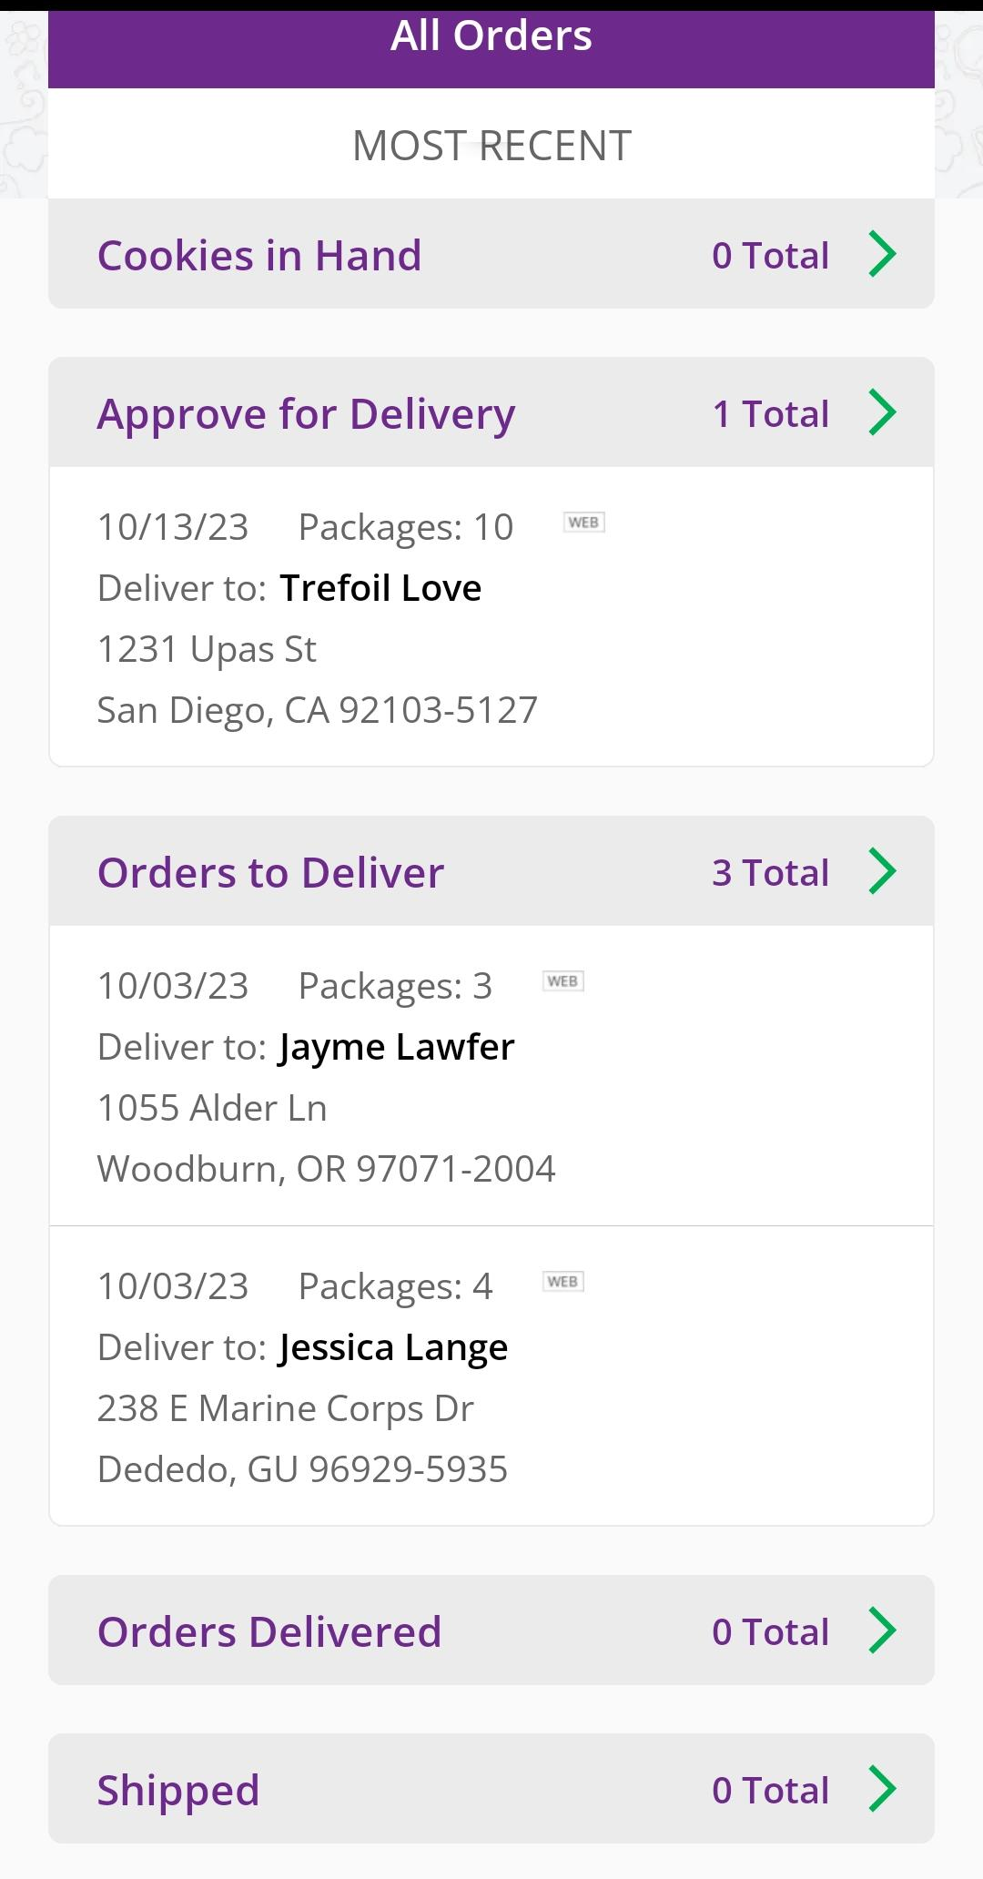
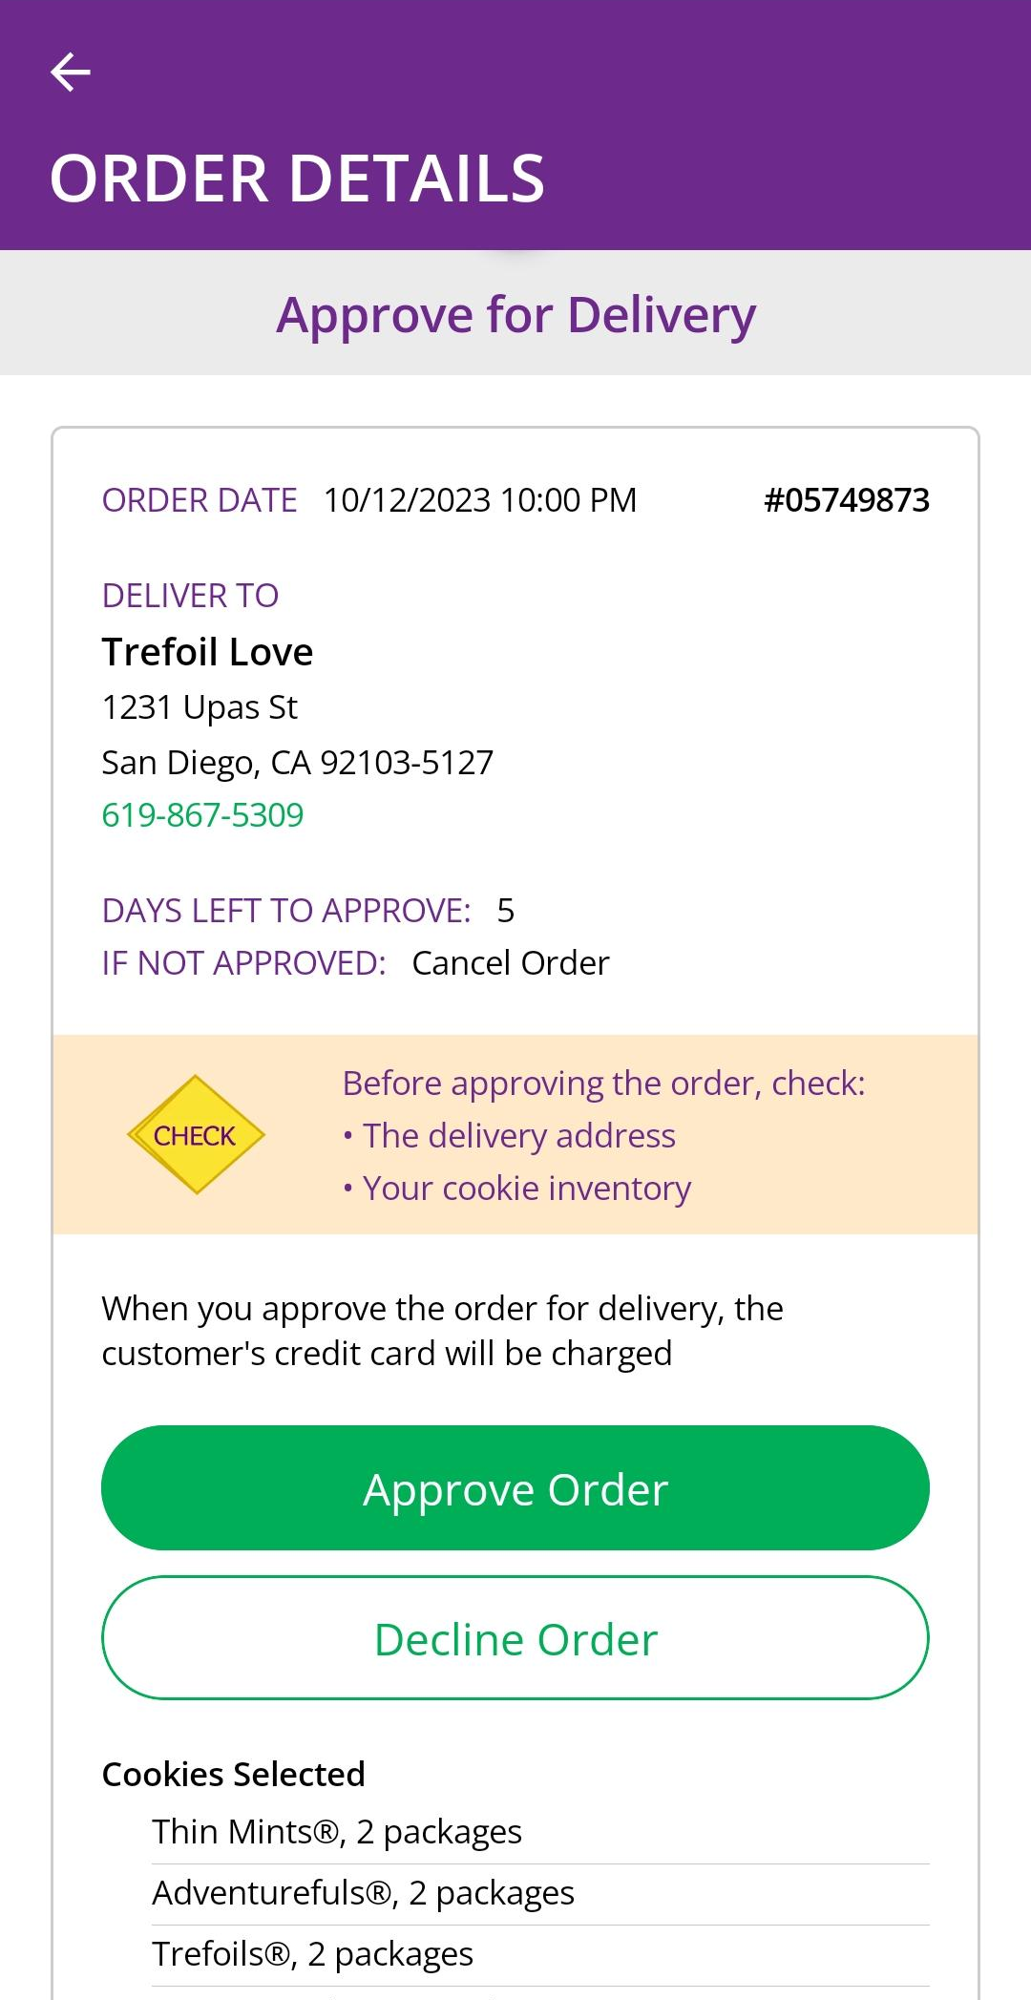
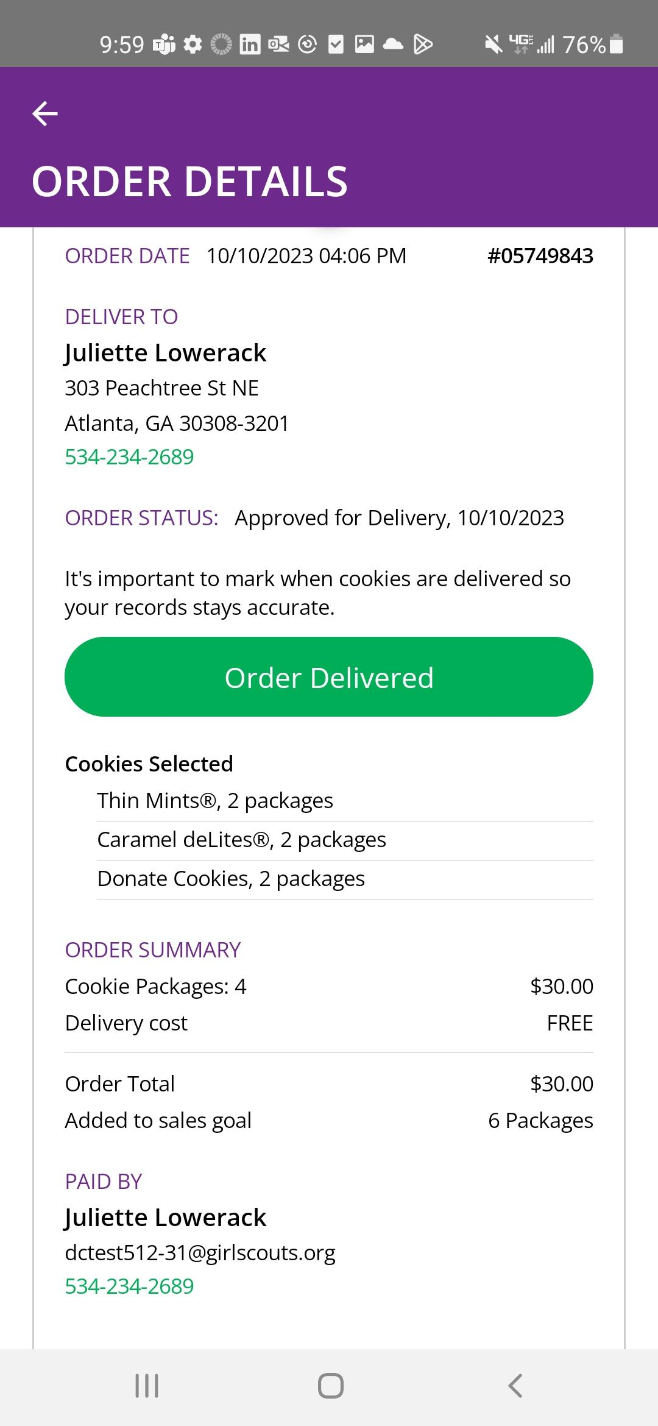
Mobile App-Viewing Orders
Order Status
Approve/ Decline Order
Click the green arrow in the section of orders you want to see more details.
Details about that customer’s order including address, packages purchased, order status, and more.
Notes:
Girl Scouts can view orders using the “All Orders” section of their app. Tapping on the “All Orders” or scrolling down will make all of your orders visible by delivery method.
To see the details for an order, click on the green arrow to view all the orders in that order type (approve for delivery, orders to deliver, shipped, etc.).
Then click the green arrow next to the specific order you want to view
The details for the order will appear and you can review the order, see the status, approve/decline order, or mark order as delivered.
Remind caregivers to review their orders often and approve/decline orders daily. Caregivers have 5 days to approve or decline an order. Please verify the address of the order before approving. You do not want to drive to Alaska to deliver an order!

